Slide 1

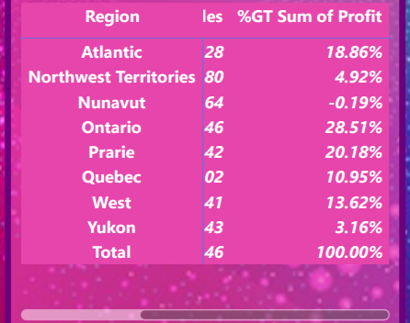
Region wise Profit
Ontarion region have most profit in 2009.
Followed by Prarie and Atlantic.
In 2010 again Ontarion region gives most profit.
Followed by West and Atlantic
In 2011, west region gives more profit.
Followed by Prarie and Ontario.
In 2012, Prarie region gives more profit.
Followed by Ontarion and West.

Slide 2
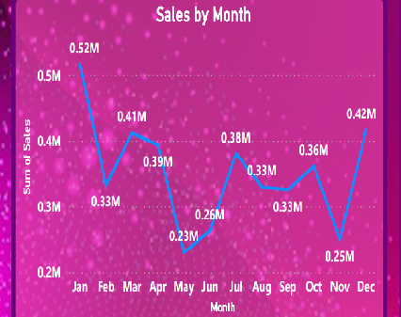
Sales by Month
In 2009 most sales happened in January month followed by December.
The sales volume in pick month is 0.52M

Slide 3
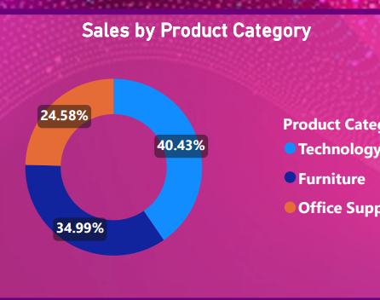
Sales by Product Category
Technology category of product sold most.
Total 40.43% of sales is of Technology category .

Slide 4
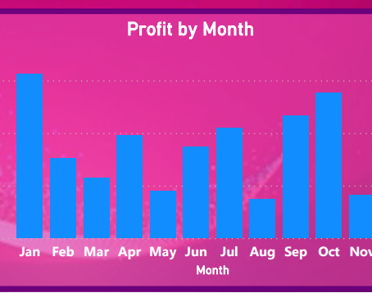
Profit by Month
January have most profit margin compare to other months.
Followed by October.

